Slide 1

RITA COPILOT
Road Information & Travel Assistant
Team members:
Dario Di Palma
Vito Guida
Mattia Tritto
Antonio Colacicco
Valerio Guido

Slide 2
Problems of drivers
With a new (or rented) car, drivers feel uncofortable because of own preferences in terms of seat, mirrors, temperature, lights, seat heating …
In a new city drivers have the feeling to be lost during the navigation.
User experience with commercial voice assistant is sometimes complicated and unreliable

Slide 3
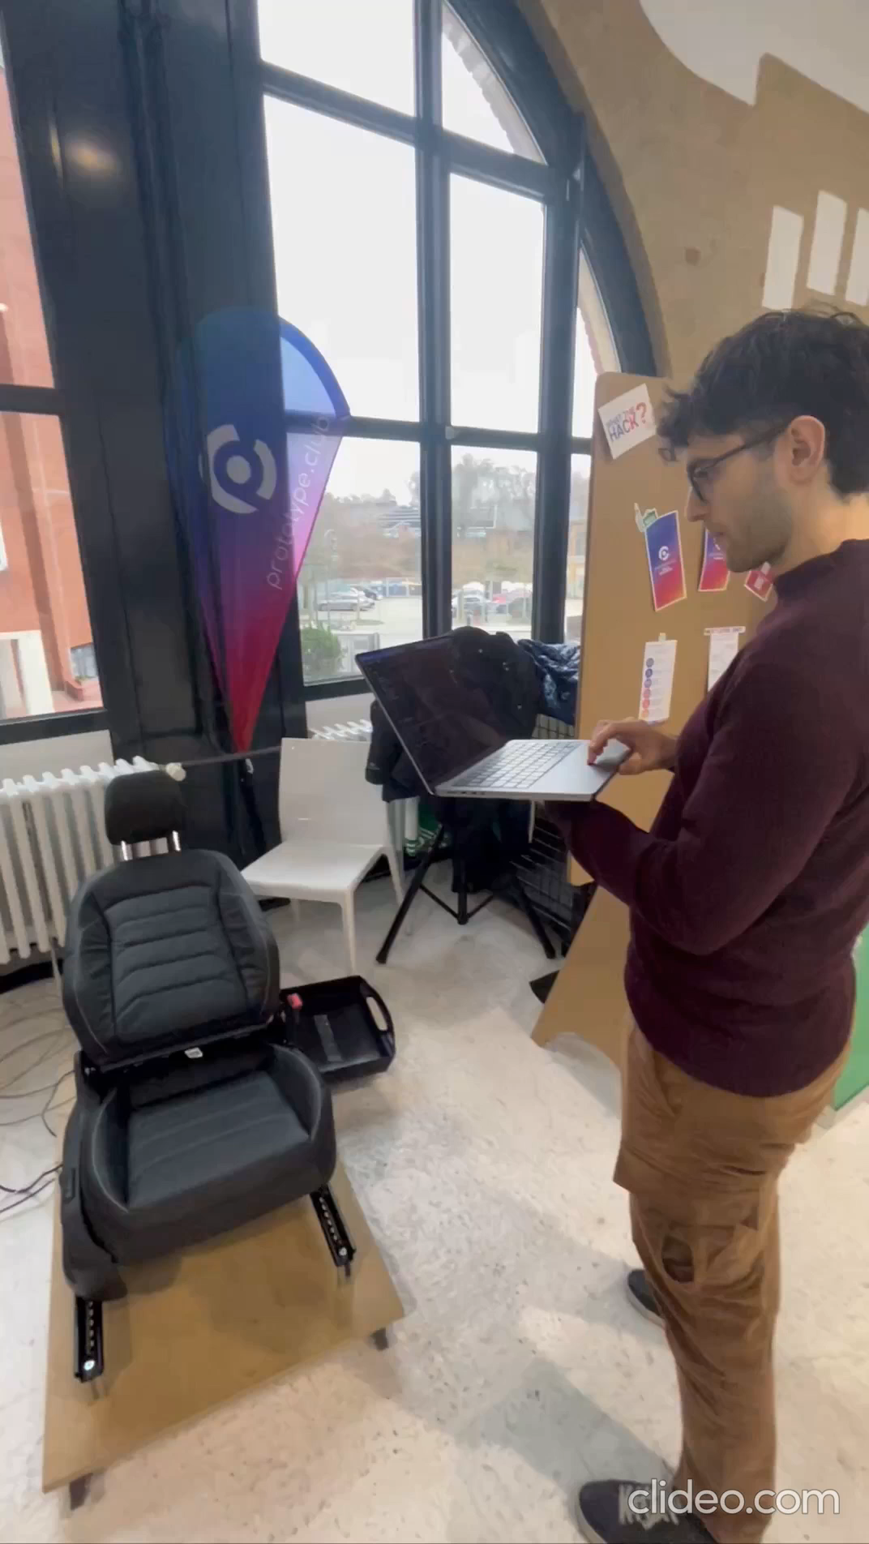
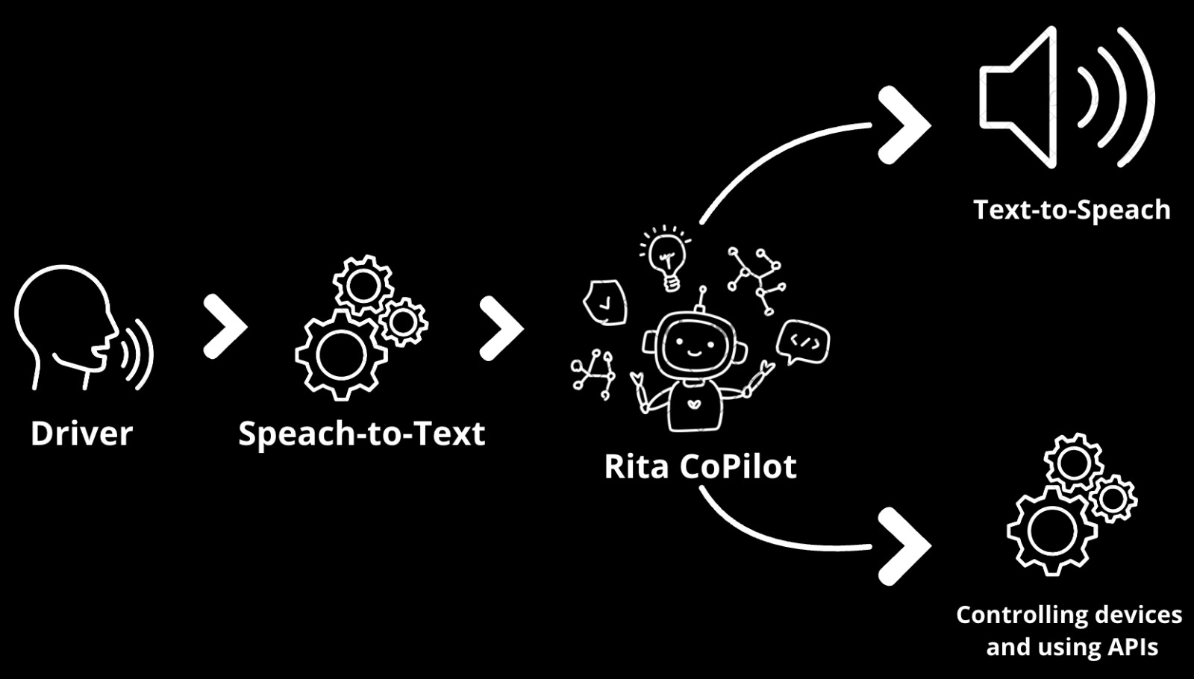
How it works

Slide 4
Model Canvas
Key Partners
Key Activities
Value Propositions
Customer Relationships
Customer Segments
Google
Apple
Bosch
ETAS
Google Cloud
Azure
AWS
OpenAi GPT-4
Google ARCore
Eclipse Kuksa
Mobile store distribution
Cloud Provisioning
Software Licensing
API consumption
System Integrator
Customized internal comfort
Augmented reality on real street views
Enhanced navigation experience
Full integration with maps and infotainement OS or mobile OS
Reduce traffic congestion due to uncertain driving
B2B2C (SLA contract)
B2C (subscription)
OEMs
Fleet owners
Drivers
Channels
OEM direct integration (embedded sw)
Mobile marketplaces (App)
Key RESOURCES
Mobile stores
IaaS providers
SaaS providers
Camera providers ECU/VCU

Slide 5
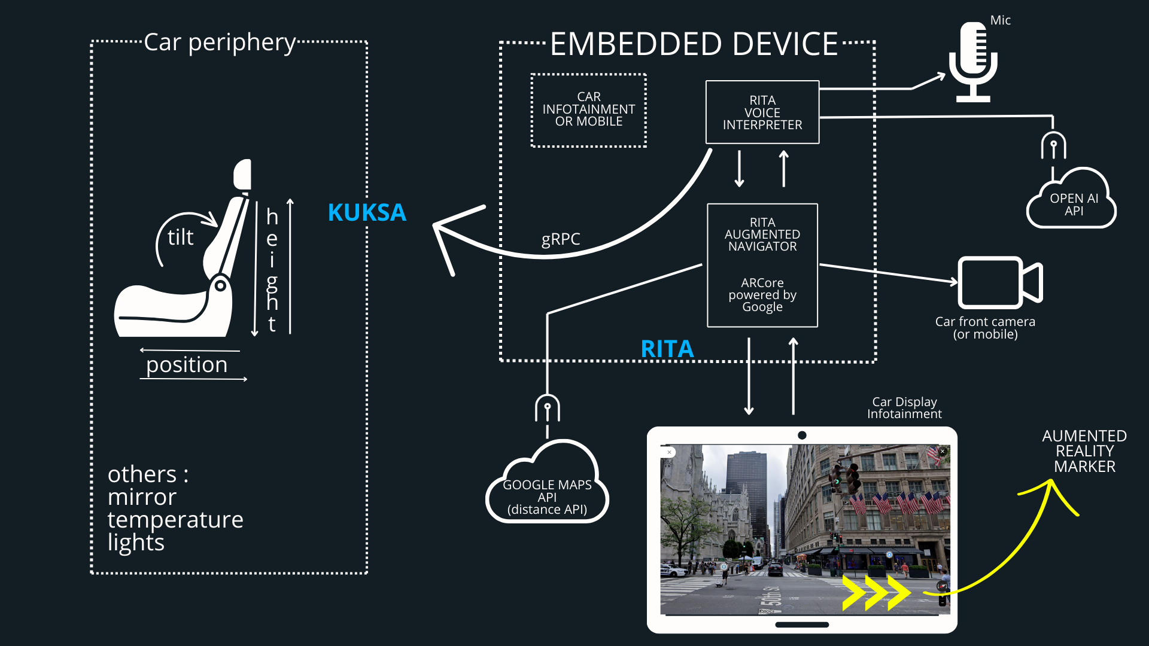
SYSTEM ARCHITECTURE

Slide 6
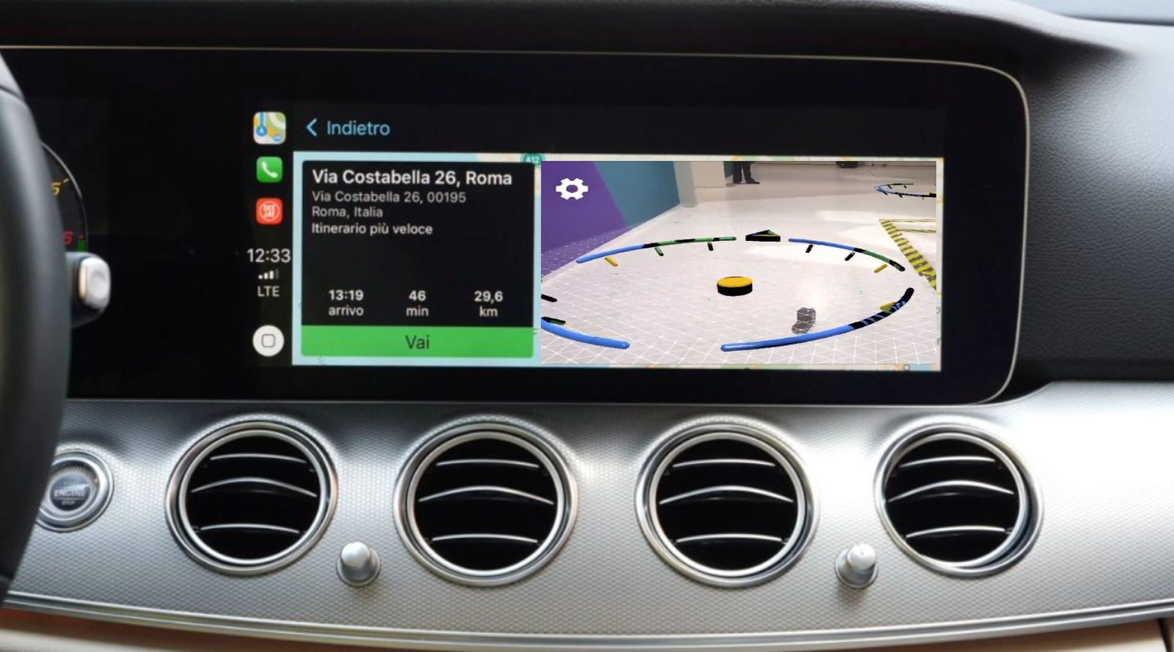
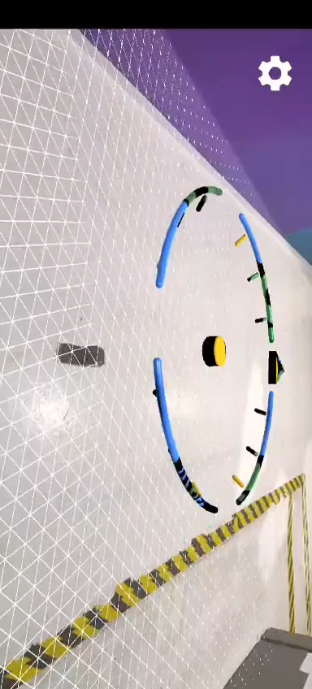
TARGET IMPLEMENTATION

Slide 7

THANKS!!

